Slide 1
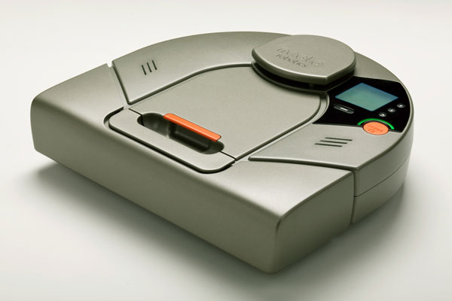
Neato XV11 Lidar Development Using PIC32MX Microcontroller
Keith Martin
NASA Robotics Mining Team

Slide 2
CRC
A Cyclical Redundancy Check is a method to verify that the received data is valid.
The CRC used here is two bytes added on the end of the data message. The two bytes are compared with the received first bytes in green below.
<start> <index> <speed_L> <speed_H> [Data 0] [Data 1] [Data 2] [Data 3] <checksum_L> <checksum_H>

Slide 3
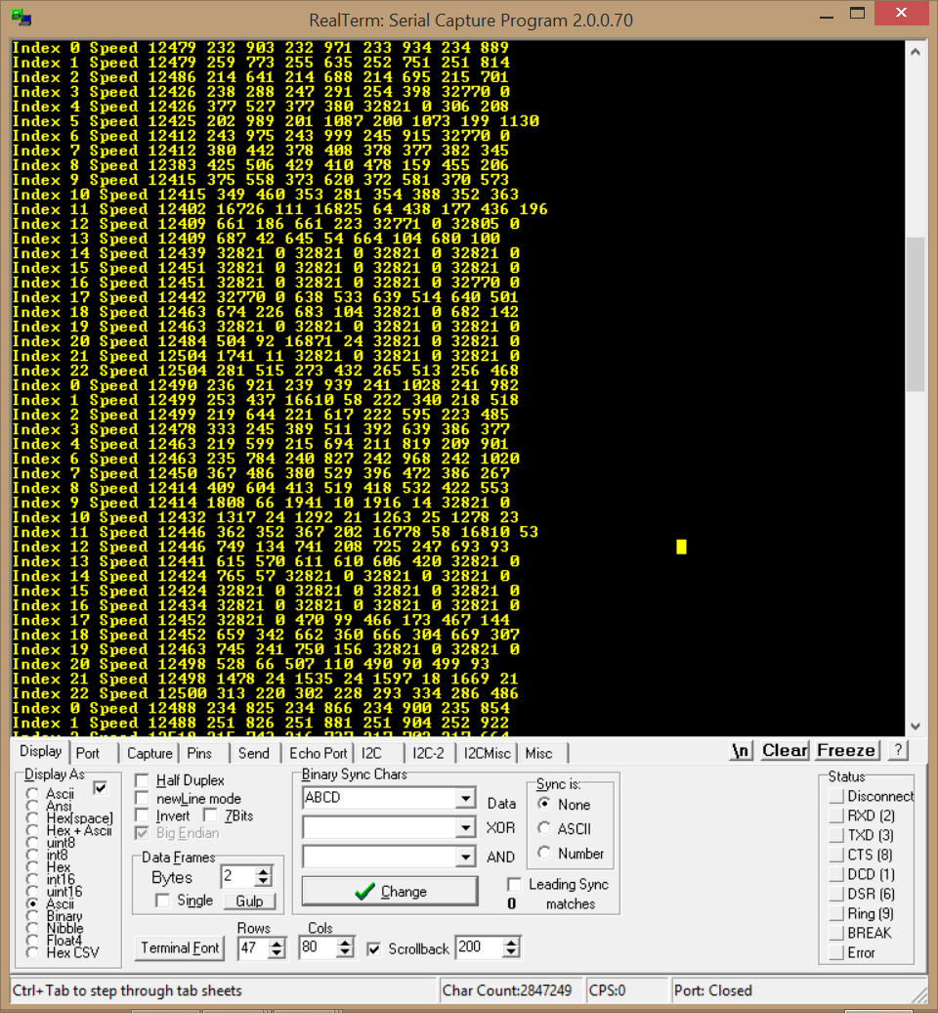
Parsed Output from Software After CRC

Slide 4
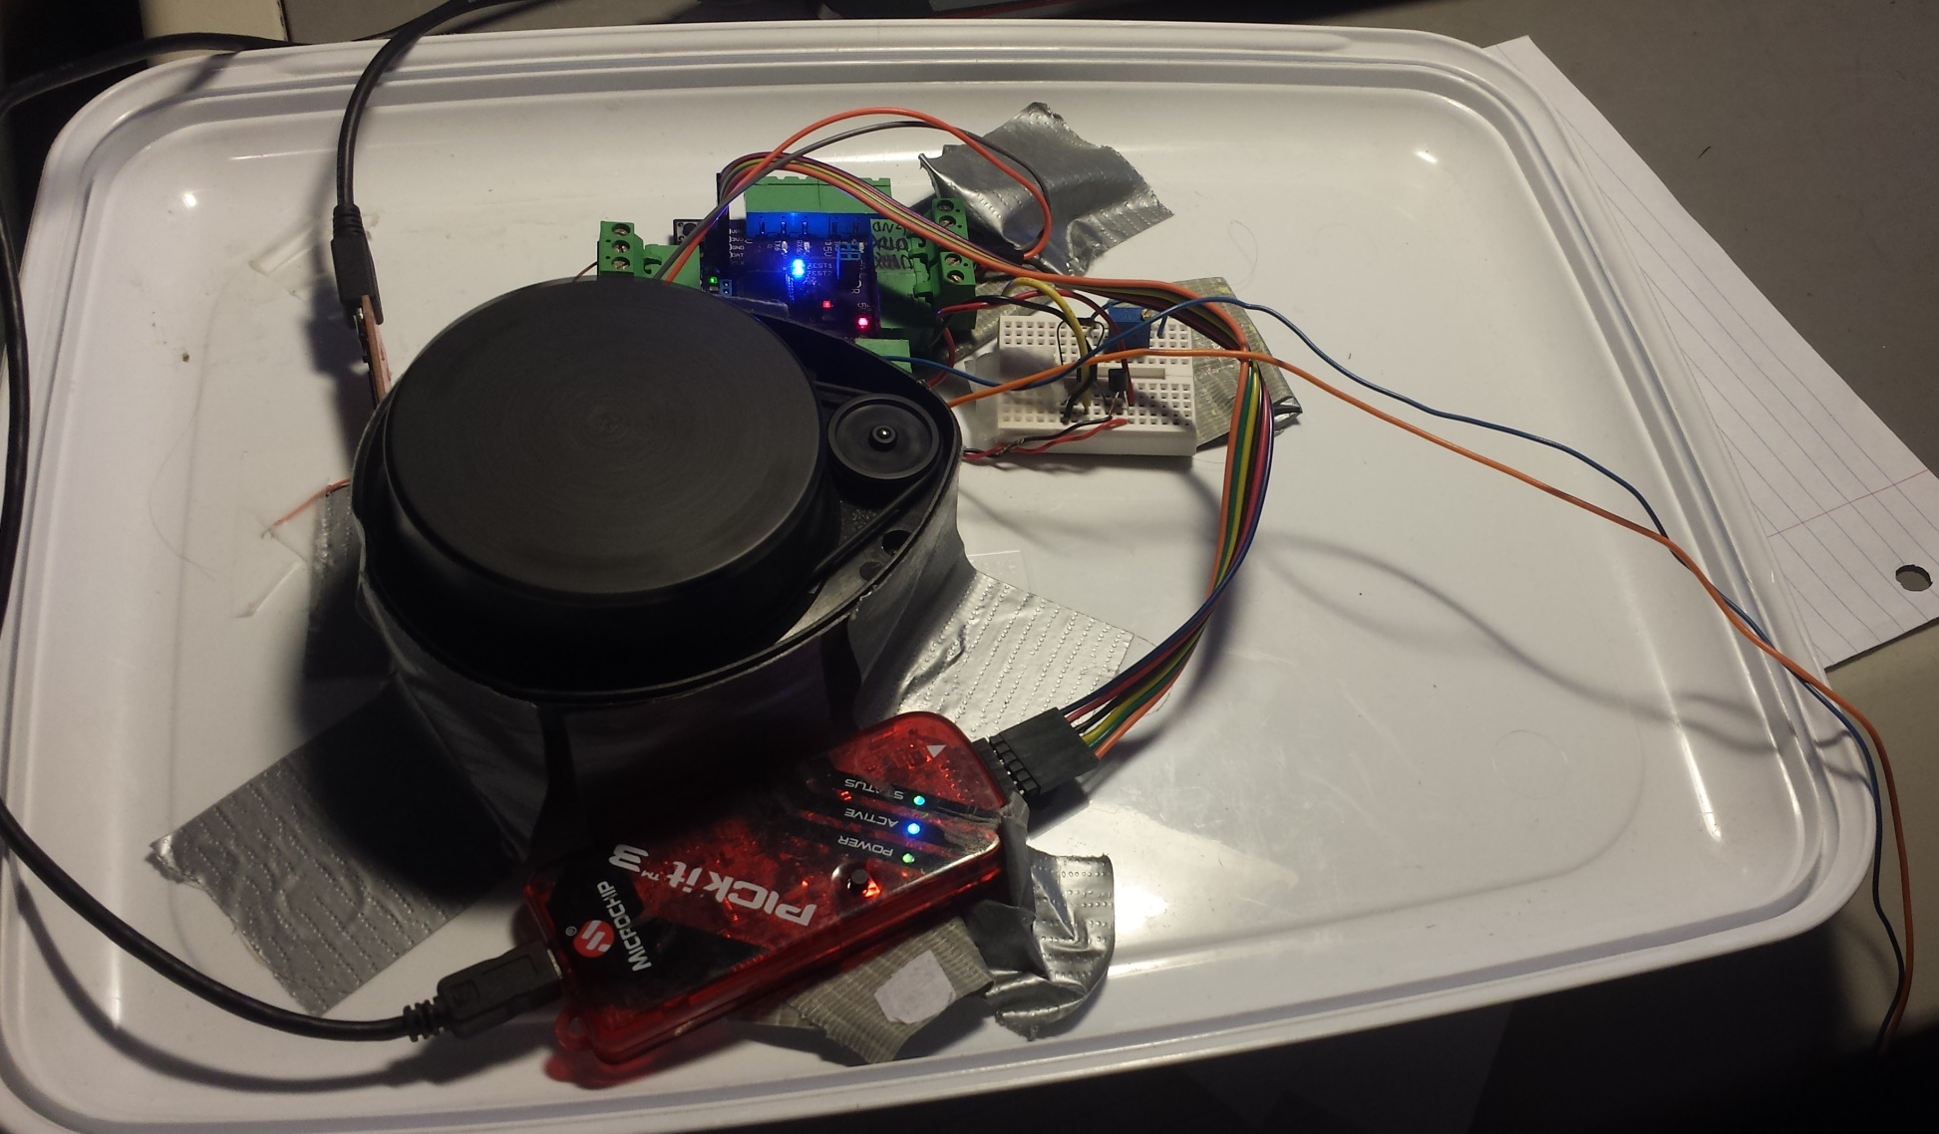
How to Hookup the Lidar Hardware

Slide 5
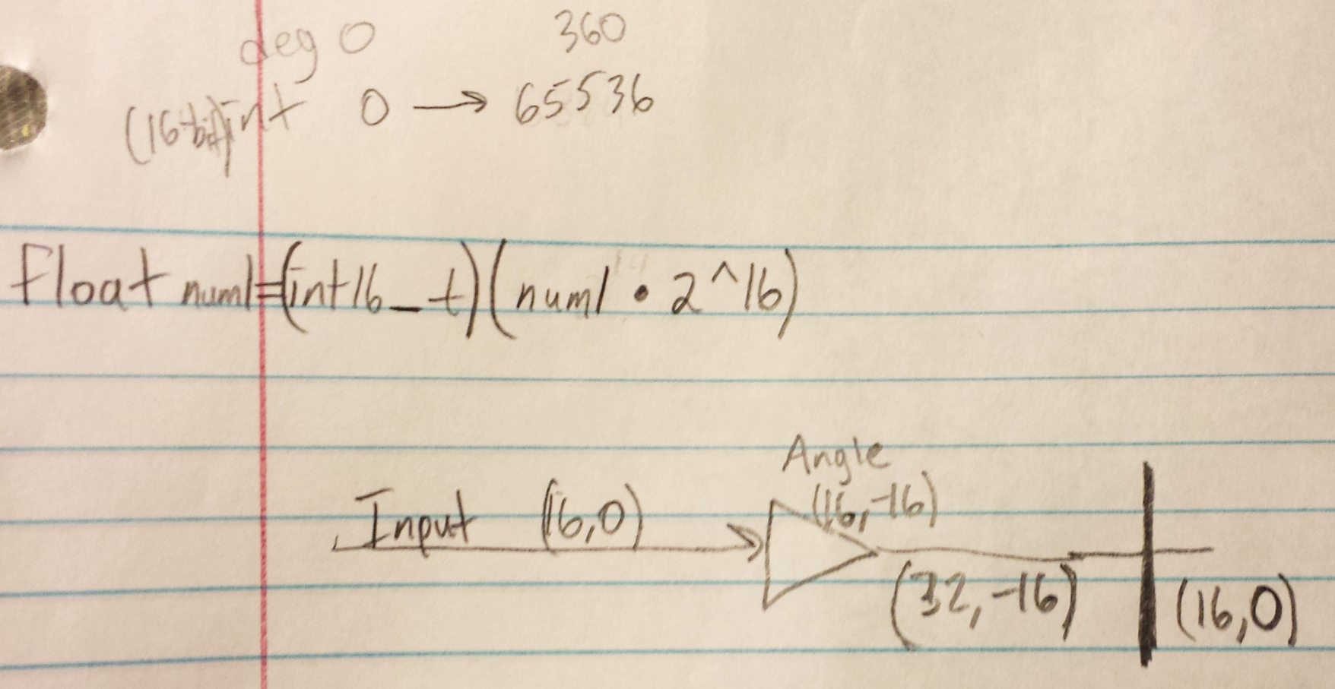
Fixed Point Math for Lookup Table

Slide 6
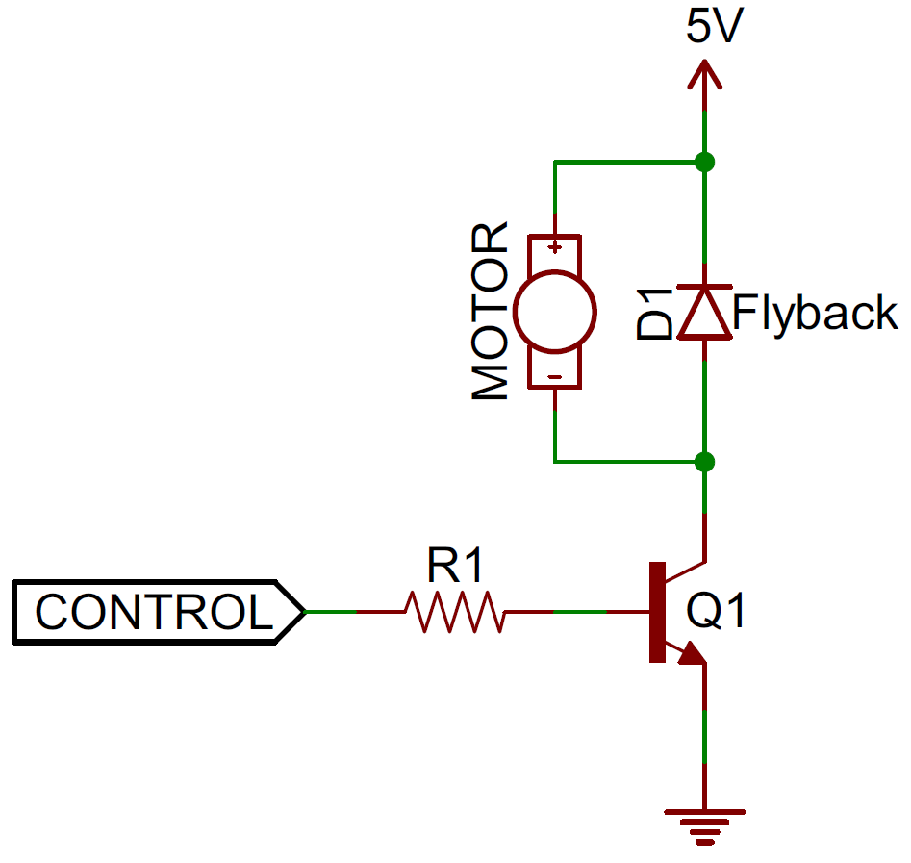
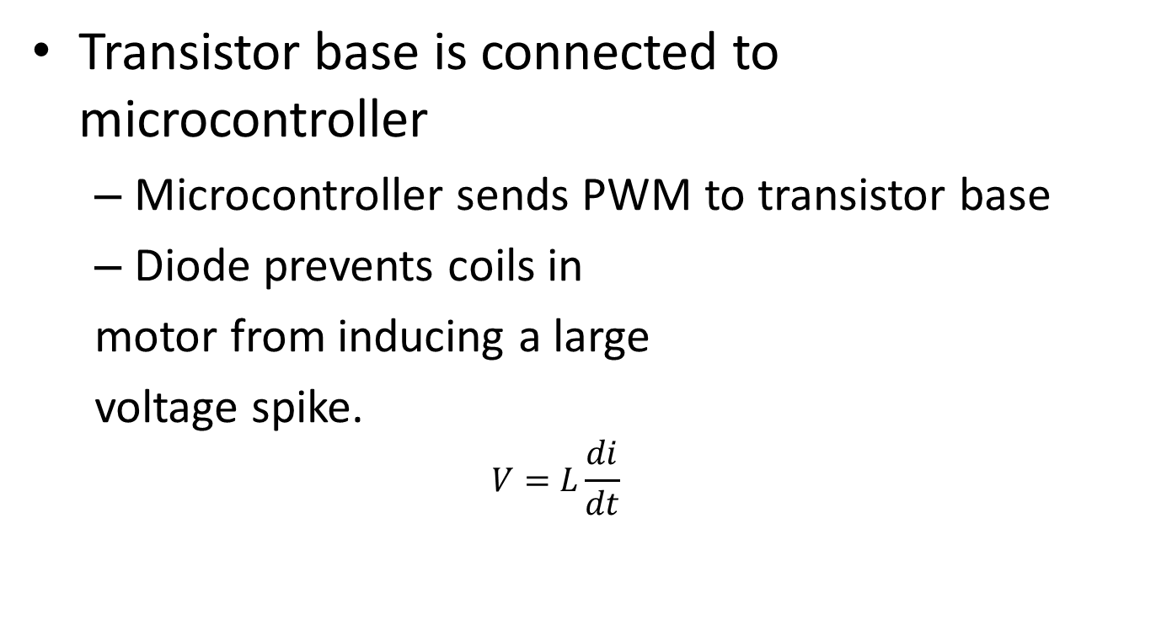
Controlling the DC Motor
Transistor base is connected to microcontroller
Microcontroller sends PWM to transistor base
Diode prevents coils in
motor from inducing a large
voltage spike.
$$V=L\frac{di}{dt}$$

Slide 7
Site Info and Repository
https://xv11hacking.wikispaces.com/LIDAR+Sens
https://github.com/keithiscool/XV11LidarDevelopmentPIC32

